Slide 1
Problem Statement Title: Diabetic Retinotherapy using Quantum Computing
Team Name: 686250-UN50G45I

Slide 2

Team members details
Team Name | 686250-UN50G45I
Institute Name/Names | KL Deemed to be University, Guntur, Andhra Pradesh
Team Members > | 1 (Leader) | 2 | 3
Name | Atukuri Bhavya Sri
Batch | Y20

Slide 3
Deliverables/Expectations for Level 2 (Idea + Code Submission)
Using Quantum Cloud:
We have performed certain tasks more efficiently than classical computers, making them for enhancing machine learning processes.
1. 100% Accuracy:
This means that the model correctly classifies all instances, indicating that there are no false positives or false negatives in its predictions.
2. 100% Precision:
Precision refers to the ratio of true positive predictions to the total positive predictions. In this case, it means that all the instances classified as positive are indeed positive, without any false positives.
3. 100% Recall:
Recall is the ratio of true positive predictions to the total actual positives. Achieving 100% recall means that the model identifies all positive cases without any false negatives.
4. 100% F1-Score:
The F1-score is the harmonic mean of precision and recall. It provides a balance between precision and recall. Achieving 100% F1-score indicates an excellent balance between accurate positive predictions and comprehensive coverage of positive cases.

Slide 4
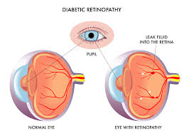
Use-cases
Quantum Neural Networks for Image Classification(P0):
Traditional image classification methods may struggle with complex image patterns. Quantum neural networks offer a potential solution
Quantum Cloud-Based Collaboration for Dataset Analysis(p1):
The cloud platform to collectively analyze retinal image datasets for diabetic retinopathy research
Quantum-Assisted Image Feature Extraction(P2):
This image analysis techniques used to extract subtle features from retinal images that indicate early signs of diabetic retinopathy.

Slide 5
Solution statement/ Proposed approach
Quantum Neural Networks for Image Classification
1. Sub-Problem: Existing image classification methods may struggle to accurately classify retinal images based on disease
Solution: These are specialized type of neural network that leverages quantum properties to enhance the processing of complex data, such as images.
2.Quantum Cloud-Based Collaboration for Dataset Analysis
Sub-Problem: Analysing large-scale retinal image datasets requires significant computational resources and collaborative efforts
Solution: Quantum cloud platforms provide researchers with access to quantum processors and computational resources through remote cloud interfaces.
3. Quantum-Assisted Image Feature Extraction
Sub-Problem: Traditional image analysis techniques struggle to extract subtle features from retinal images that indicate diabetic retinopathy progression
Solution: Convert pixel values of retinal images into quantum states using techniques like quantum amplitude encoding.

Slide 6
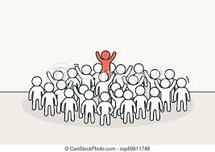
Limitations
High Prevalence
Limited Access to Healthcare
Variability in Disease Progression
Asymptomatic Early Stages
Patient Compliance
Late Detection
Patient Education and Empowerment
Complex Disease Progression
Impact on Quality of Life

Slide 7
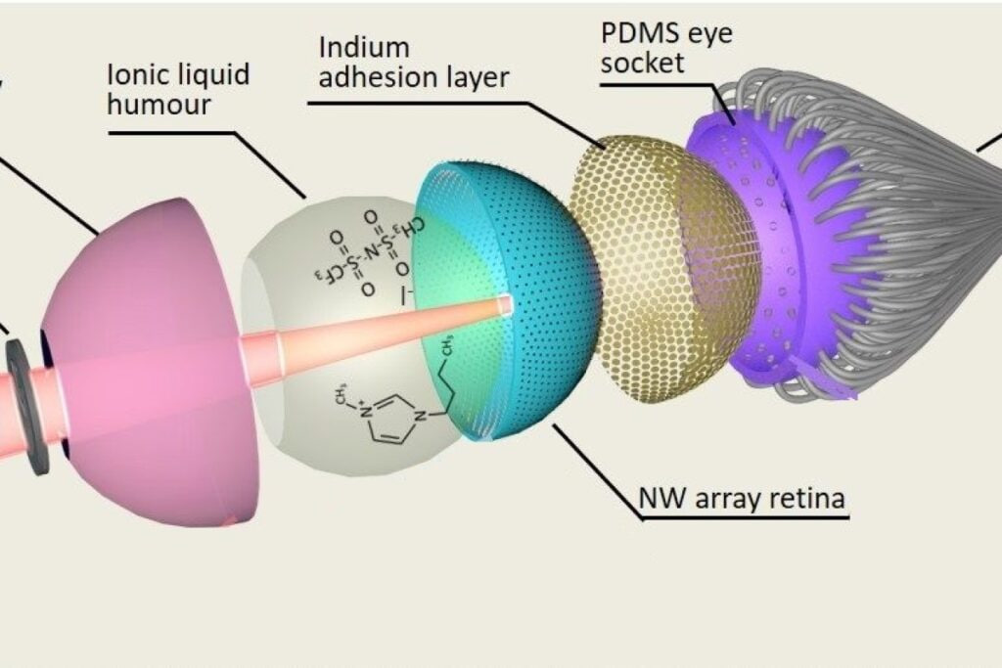
Future Scope
Telemedicine and Remote Monitoring : They enable remote retinal
Screening and monitoring , allowing individuals with diabetes
Nanotechnology and Drug Delivery:
lead to innovative drug delivery systems targeting the retina.
Neuroprotection Strategies: retinal neurons and blood vessels
could mitigate the progression of diabetic retinopathy and preserve
visual function.
Virtual Reality and Simulation: Virtual reality platforms can
aid in educating healthcare professionals and students
Regenerative Medicine: Ongoing research into regenerating
retinal tissue through cell-based therapies or bioengineered
Integration with Diabetes Management: Integrating
retinopathy screening and management with broader diabetes
care programs
Early Detection Algorithms: Developing advanced algorithms
that can identify subtle changes in retinal images

Slide 8
Finally Our complete project
https://github.com/klu2000031625/Diabetic-Retinopathy.git

Slide 9
Thank You

